Slide 1
CHAPTER 3
LOGIC
BOOLEANS

Slide 2
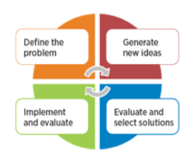
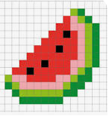

What have we seen so far ?
Chapter 1
Chapter 2
Chapter 3
NOW !
A7E456
BF55S
How to SOLVE
Problems ?
How to encode information
into BINARY, HEXA ?
How to think
with BOOLEANS ?

Slide 3


QUIZ
5 MIN
CLASS
We want to store a number whose values go
From 0 to 1000
Question : how many bits do we need to store this number ?

Slide 4
QUIZ
5 MIN
CLASS
We want to store a number whose values go
From 0 to 1000
Question : how many bits do we need to store this number ?
10 bits !!
Because 2^10 = 1024
So with 10 bits we can express values from 0 to 1023

Slide 5
EXPLAIN
5 MIN
CLASS
X = 3 + 4
What is the value of X ?

Slide 6
EXPLAIN
5 MIN
CLASS
X = 3 + 4
7
What is the value of X ?

Slide 7
EXPLAIN
5 MIN
CLASS
X = 3 > 4
What is the value of X ?
< less than
> greater than
== equal to
<= less than or equal to
>= greater than or equal to

Slide 8
EXPLAIN
5 MIN
CLASS
X = 3 > 4
False : 3 is less than 4
What is the value of X ?
< less than
> greater than
== equal to
<= less than or equal to
>= greater than or equal to

Slide 9
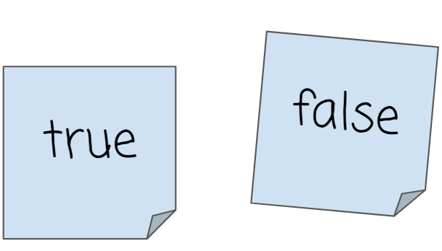
EXPLAIN
5 MIN
CLASS
When something can only be True or False we use a
Boolean
Question : how many bit do we need to store a Boolean ?

Slide 10
How many bit do we need to store a Boolean ?
We can encode the boolean with 2 values : 0 and 1
1
0
So we need only 1 bit to store a boolean !!

Slide 11

EXPLAIN
To resolve an expression , we need to go step by step
5 MIN
CLASS
3
+
6
<
8

Slide 12
EXPLAIN
To resolve an expression , we need to go step by step
5 MIN
CLASS
3
+
6
<
8
9
<
8
STEP 1

Slide 13
EXPLAIN
To resolve an expression , we need to go step by step
5 MIN
CLASS
3
+
6
<
8
9
<
8
STEP 1
False
STEP 2

Slide 14

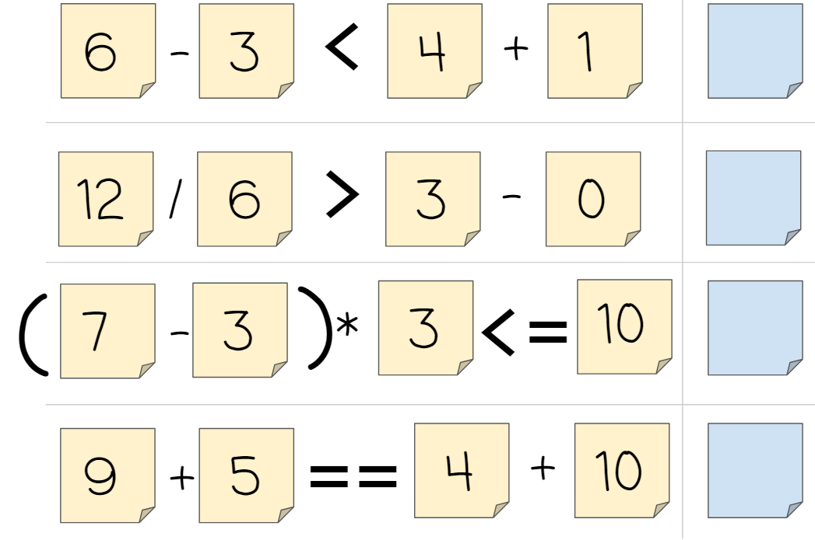
PRACTICE
Revolve, step by step, the 4 questions:
5 MIN
INDIV
Q1
Q2
Q3
Q4

Slide 15
PRACTICE
Which information can be stored using a boolean ?
5 MIN
INDIV
A
The number of cats I have
E
My height
B
If I have 3 cats
F
If I’m taller than 1,7m
C
If I can drive a car
G
Today temperature
D
My first name
H
Today is sunny or not

Slide 16
PRACTICE
Which information can be stored using a boolean ?
5 MIN
INDIV
NUMBER
NUMBER
A
The number of cats I have
E
My height
BOOLEAN
B
If I have 3 cats
BOOLEAN
F
If I’m taller than 1,7m
C
If I can drive a car
BOOLEAN
G
Today temperature
NUMBER
D
My first name
H
Today is sunny or not
TEXT
BOOLEAN

Slide 17
EXPLAIN
Which number is valid for this condition ?
5 MIN
CLASS
value <= 5
5
7
4
9
2
6

Slide 18
EXPLAIN
Which number is valid for this condition ?
5 MIN
CLASS
value <= 5
5
7
4
9
2
6

Slide 19
EXPLAIN
Which number is valid for this condition ?
5 MIN
CLASS
color ==
5
7
4
9
2
6

Slide 20
EXPLAIN
Which number is valid for this condition ?
5 MIN
CLASS
color ==
5
7
4
9
2
6

Slide 21
EXPLAIN
Which number is valid for this condition ?
5 MIN
CLASS
color ==
value <5
AND
5
7
4
9
2
6

Slide 22
EXPLAIN
Which number is valid for this condition ?
5 MIN
CLASS
color ==
value <5
AND
5
7
4
9
2
6

Slide 23
EXPLAIN
Which number is valid for this condition ?
5 MIN
CLASS
color ==
value <5
OR
5
2
4
4
2
6

Slide 24
EXPLAIN
Which number is valid for this condition ?
5 MIN
CLASS
color ==
value <5
OR
5
2
4
4
2
6

Slide 25
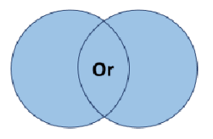
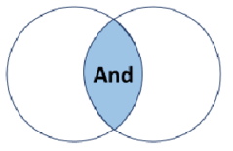
EXPLAIN
We can combine conditions
using and operators
5 MIN
CLASS
OR
AND
color ==
value <5
color ==
AND
value <5
OR
VALUE <5
COLOR
VALUE <5
COLOR

Slide 26


QUIZ
True or False ?
5 MIN
CLASS
FALSE
TRUE
5 < 3

Slide 27
QUIZ
True or False ?
5 MIN
CLASS
FALSE
TRUE
5 == 3

Slide 28
QUIZ
True or False ?
5 MIN
CLASS
FALSE
TRUE
1 < 3
5 < 3
AND

Slide 29
QUIZ
True or False ?
5 MIN
CLASS
FALSE
TRUE
1 > 3
5 > 3
OR

Slide 30
QUIZ
True or False ?
5 MIN
CLASS
FALSE
TRUE
1 > 3
5 > 8
OR

Slide 31
QUIZ
True or False ?
5 MIN
CLASS
FALSE
TRUE
1 < 3
5 < 8
AND

Slide 32
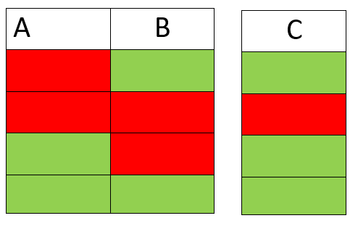
EXPLAIN
c = a or b
5 MIN
CLASS
FALSE
TRUE
TRUE
True if either
A and B
Are True
FALSE
FALSE
FALSE
TRUE
FALSE
TRUE
TRUE
TRUE
TRUE

Slide 33
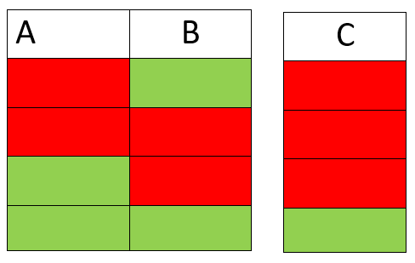
EXPLAIN
c = a and b
5 MIN
CLASS
FALSE
TRUE
FALSE
FALSE
FALSE
FALSE
TRUE
FALSE
FALSE
True only
If both A and B
Are True
TRUE
TRUE
TRUE

Slide 34
PRACTICE
Revolve the following expression
5 MIN
INDIV
((3 < 5) AND ( (5 – 2) <= 3 )) OR (( (4*2) >= 5) AND ((9-2) == 7) )

Slide 35
PRACTICE
Revolve the following expression
5 MIN
INDIV
((8 > 5) OR ((5 – 2) < 3)) OR (((3*2) >= 5) AND ((12-2) <= 10) )

Slide 36
PRACTICE
Revolve the following expression
5 MIN
INDIV
(( (20/2 >= 9) OR True) AND ( ((3-1)*2 < 4) OR (5 == 3) ))
AND
(((1+2) < 2) AND True) OR (True OR False) )

Slide 37
PRACTICE
Revolve the following expression
5 MIN
INDIV
((15 <= (5*3)) OR (5 <= 9)) OR (((5*2) >= 10) AND (2 == 2) )

Slide 38
PRACTICE
Revolve the following expression
5 MIN
INDIV
((False OR True) AND (True OR True)) AND ((True AND True) OR (False OR False) )

Slide 39
PRACTICE
Revolve the following expression
5 MIN
INDIV
((18 == (6*3)) OR ((5 + 2) <= 9)) OR (((7*2) <= 10) AND ((1+2) < 2) )

